Slide 1
Breaking Borders to Change Water Availability in Bolivia
Aobei Cheng | Jacob Dahneke | Bo Yang

Slide 2
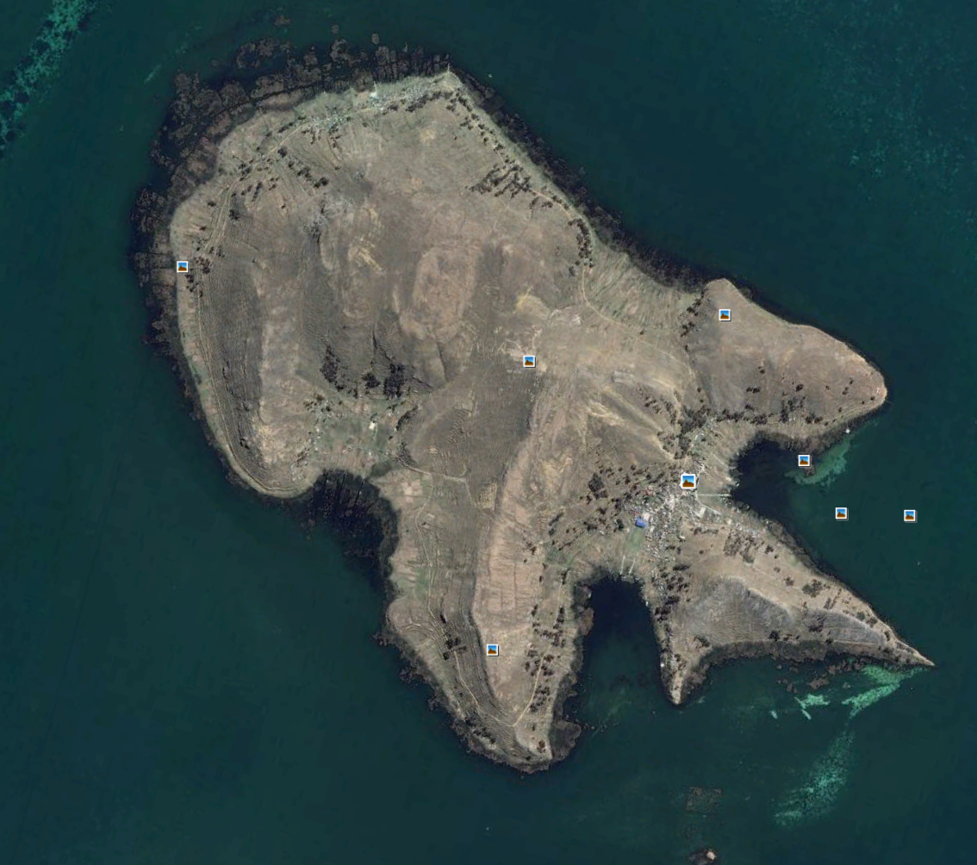
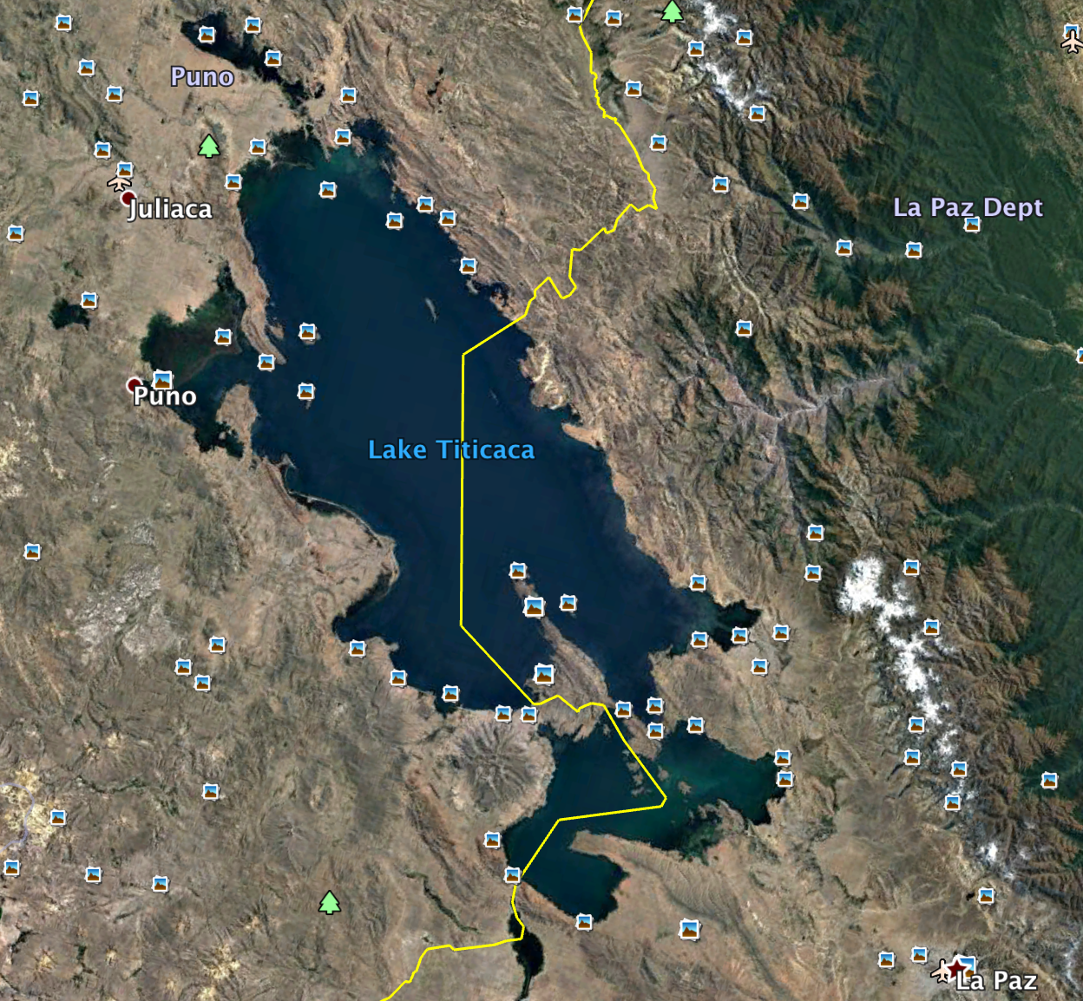
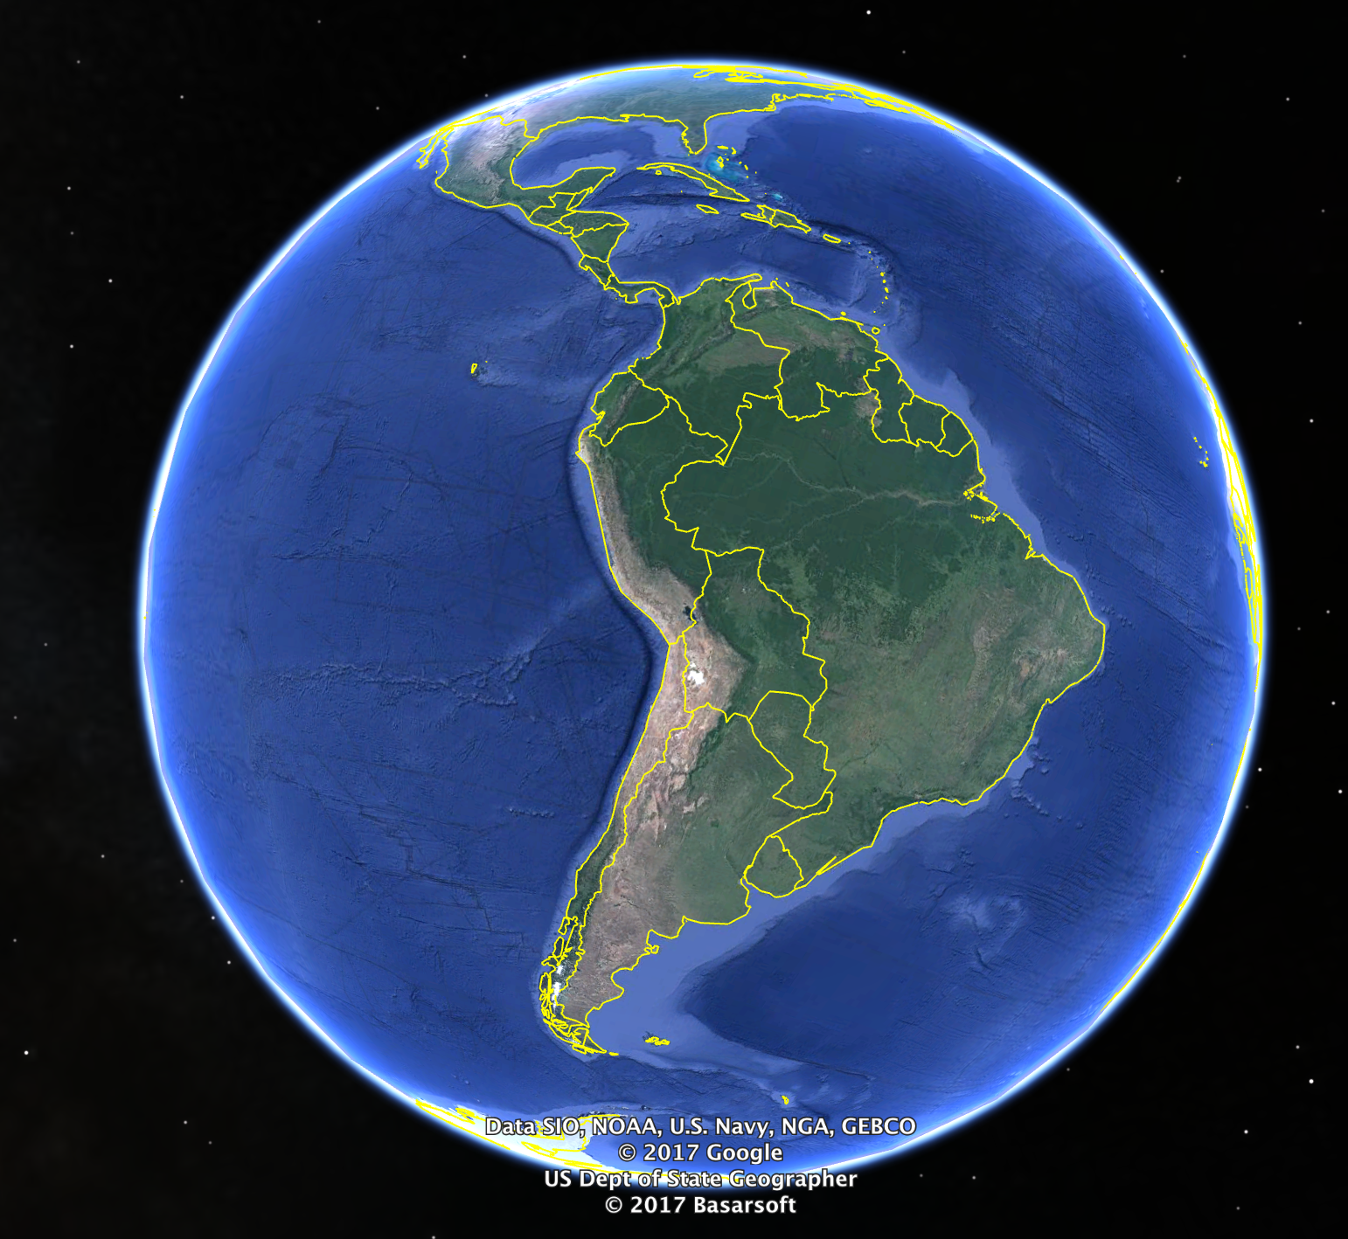
Background
Location: Suriqui Island
Water source: Lake Titicaca
The inhabitants are in the immediate need of the water supply and treatment plant
AguaClara is trying to apply its current water treatment technology to the local community, to offer the residents safe water at a sustainable and low cost.
Sssssnakes| Fall 2017

Slide 3
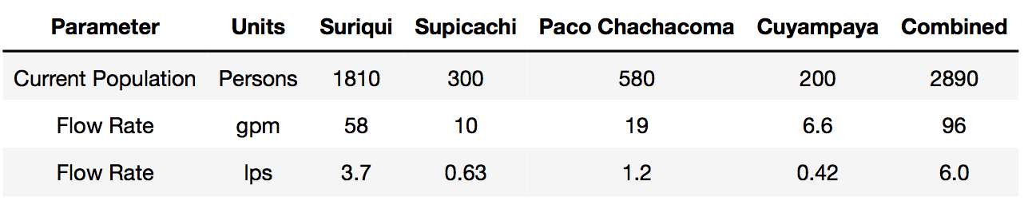
Proposed Solution
Single Plant
Scale (100L/capita/day, no metering)
Elevation of Plant (Headloss = 7.3m at velocity = 13 cm/s)
Distribution System

Slide 4
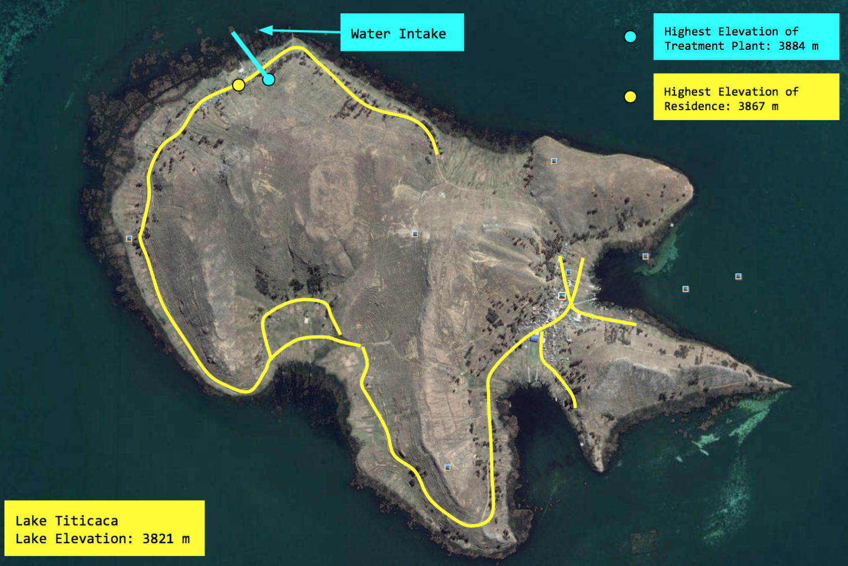
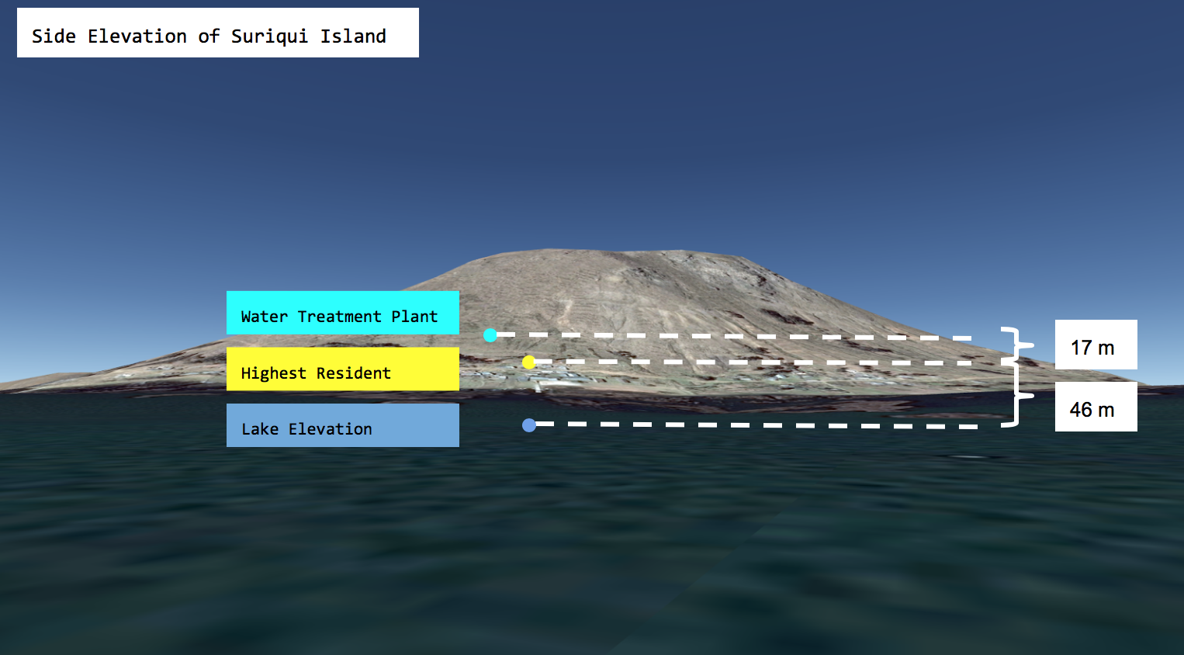
Proposed Plant Location & Distribution System

Slide 5
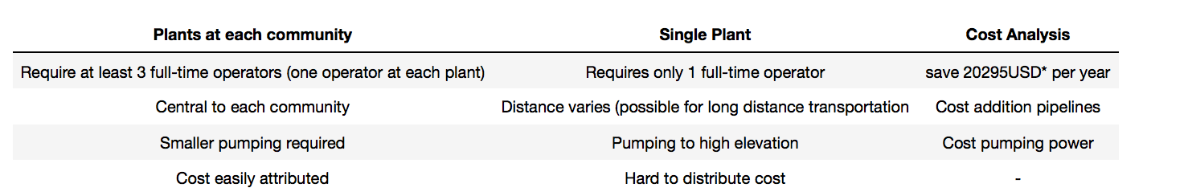
Alternatives & Constraints
Constraints Including:
financial limitations
reliable energy sources
locally available construction materials
quality of water intake (Untreated sewage from more than 20 nearby cities; 15 tons Mercury/yr; )
and minimal funds for maintenance.

Slide 6
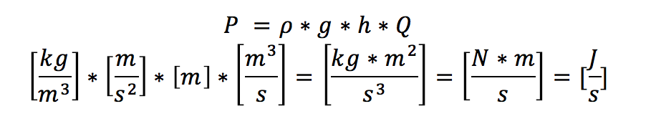
Energy Requirement
Height Required =
Ability to cover all residents in the area
Highest elevation of the resident area is 46 m so we set another 10 m on top of it to make sure it can distribute water to all residential areas
+ Major Headloss of the transmission pipes
We assume a 13 cm/s water velocity and recognize a 7.33 m headloss
+ etc.
= 64 m ~ 5.049 hp

Slide 7
Energy Sources
Diesel
Pros:
7/24 Operation and easy operation techniques
No storage tanks needed
Fair prices for the diesel-based pumps
Cons:
$$$
Poor quality of diesel supplies in Bolivia
Unpredictable future diesel import from Chile
Solar
Pros:
Less expensive
More sustainable
Less construction
Eliminates issue of variability
Ability to expand and produce electricity for island
Cons:
10% energy loss from input of battery to usable energy
Specialized operator education
Possibly high installation cost in Bolivia

Slide 8
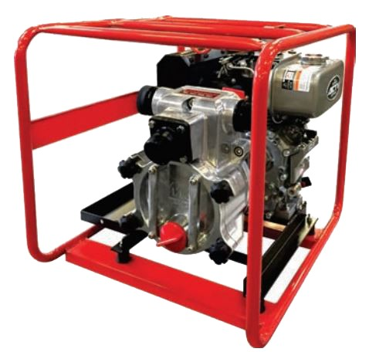
Diesel-based Pumping
Diesel in Bolivia:
Mainly imported from Chile and relevantly limited compared to other fuels such as gasoline in Bolivia in early 2000s
Nowadays, more relaxed policies on the quota check and domestic usage of Diesel
Price: 3.75 Boliviano Dollars per Liter, which is 0.53 USD (After subsidization by Bolivian Government)
High Sulfur inside and therefore high damages to the pumping engine
Total Cost = Purchase of Pump (2 renews every 5 year)
Purchase of Safety Tanks for Transportation
Fuel Cost = 235316 USD
Assume there is an existing transportation method from the mainland to the island, so no transportation cost needed!

Slide 9
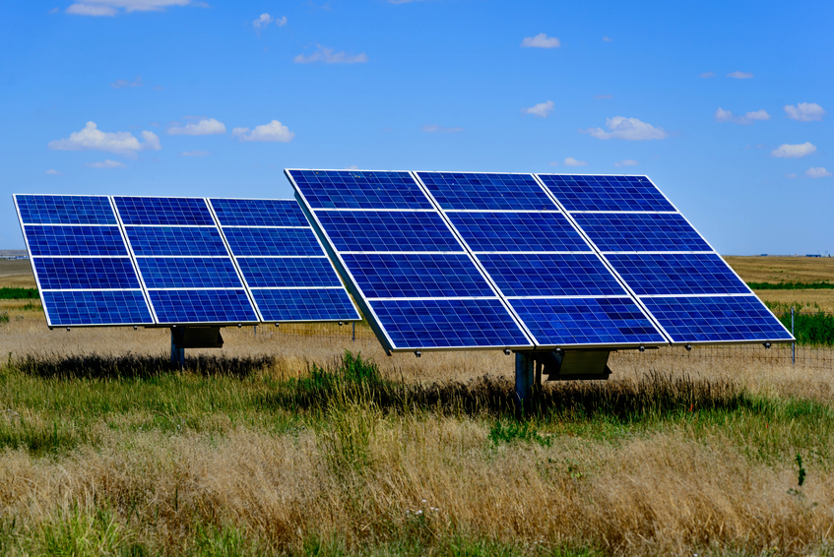
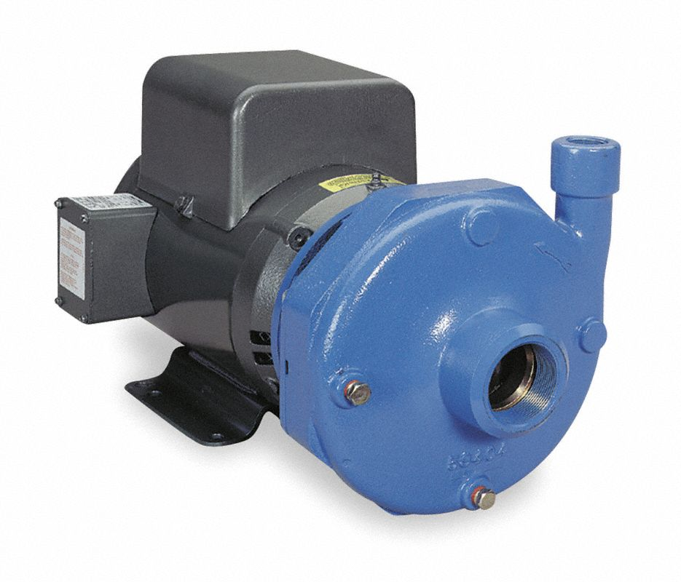
Solar Powered Pumping Options
We analyzed two different options for meeting
the pumping demands. Both use the same size
solar panels and pump. The differences are...
Pumping system with battery storage
Pumping system with tank

Slide 10
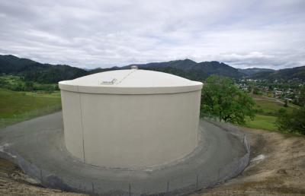
Storage Tank Option
Smaller Solar array because there is no inefficiency from batteries
Required to meet the constant flow through the plant of 6 Liters/s
Will pump dirty water up to the plant
High storage tank costs
Vulnerable to variability even with 10% increased size of solar system
Required maintenance on tank, and eventually have to replace
Cost of total pumping system, solar panels, and storage tank over 30 years: $104,479

Slide 11
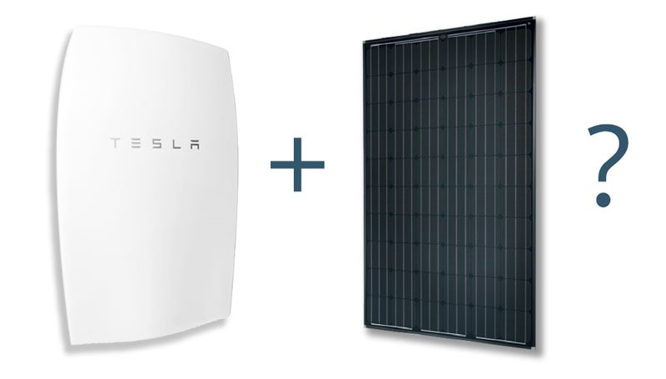
Battery Storage Option
There is more energy required because the batteries are 90% efficient
Eliminates variability problems and the need for a storage tank
Could increase the solar capacity to deliver constant electricity to the community, because there is extra storage in battery system
Cost of total pumping system, solar panels, and battery system over 30 years: $61,877
https://vimeo.com/198905461

Slide 12
Conclusion
Centralized singe water treatment plant
Integrated Distribution system for all islands
Solar Powered Pumps outstand diesel based on on cost effectiveness and long-term sustainability
Battery storage option largely reduces the cost compared with storage tank options with the total cost as $61,877 USD

